Slide 1

Securing Your Home with IOT: A Smart Security System
Mentor:
Prof. Umesh Raut
Group Members:
Amir Shakeel – PF12
Ankit Kumar-PF24
Swayam Sharma-PF30
Parth Mogadpally-PF43

Slide 2

TOPICS:
Literature Survey
Unlock the Benefits of IoT-Based Smart Security
Stay Connected with Smart Security
The Benefits of an IoT-Based Smart Security System
Real-Time Notifications and Live Camera Feeds
System Architecture and Design
Methodologies/Algorithms Used
Basic Details Implementation
References
Conclusion

Slide 3

Unlock the Benefits of IoT-Based Smart Security
The Internet of Things (IoT) has revolutionized the way we think about security. IoT-based smart security systems are the perfect way to keep your home safe and secure. With sensors that track movement and notify the owner of the house, you can rest easy knowing your home is being monitored. Plus, when something is detected, the system can start a live camera feed to give you a real-time view of what’s happening.
IoT-based smart security systems are also easy to install and maintain. With a few simple steps, you can have your home monitored and secure within minutes. Plus, you can customize the settings to fit your needs, so you can be sure your home is always safe and secure.

Slide 4
LITERATURE SURVEY
SR No | TITLE | AUTHOR | YEAR | REMARKS
1 | "Raspberry Pi Based Smart Home Security System" | Deepali Kamthania | 2019 | This paper describes a smart home security system using Raspberry Pi, PIR motion sensors, and a camera module. The system can detect intruders and send a notification to the homeowner via email..
2 | "Smart Home Security System Based on Raspberry Pi" | Shijia Wang | 2021 | This paper proposes a smart home security system that uses Raspberry Pi, a camera module, and OpenCV for motion detection. The system can be controlled using a web interface and can send notifications to the homeowner via email or SMS.
3 | "Smart Home Security System Using Raspberry Pi and PIR Sensor" | S. K. M. Rafiul Islam | 2021 | This paper presents a smart home security system that uses Raspberry Pi, PIR motion sensors, and a camera module. The system can detect motion and send notifications to the homeowner via email or mobile app.
4 | "IoT-based Smart Home Security System using Raspberry Pi" | Srinidhi K | 2021 | This paper proposes a smart home security system using Raspberry Pi, PIR motion sensors, and a camera module. The system can detect motion and send notifications to the homeowner via email or mobile app.
5 | "Raspberry Pi Based Home Security System with Email Alert and Image Capture" | Sandhya Rani V | 2021 | This paper presents a smart home security system using Raspberry Pi, a camera module, and PIR motion sensors. The system can capture images of intruders and send notifications to the homeowner via email.
by Deepali Kamthania et al. (2019) This paper describes a smart home security system using Raspberry Pi, PIR motion sensors, and a camera module. The system can detect intruders and send a notification to the homeowner via email. The authors also propose using machine learning algorithms to improve the accuracy of the system.
"Smart Home Security System Based on Raspberry Pi" by Shijia Wang et al. (2021) This paper proposes a smart home security system that uses Raspberry Pi, a camera module, and OpenCV for motion detection. The system can be controlled using a web interface and can send notifications to the homeowner via email or SMS. The authors also suggest using cloud-based storage for storing surveillance footage.
"Smart Home Security System Using Raspberry Pi and PIR Sensor" by S. K. M. Rafiul Islam et al. (2021) This paper presents a smart home security system that uses Raspberry Pi, PIR motion sensors, and a camera module. The system can detect motion and send notifications to the homeowner via email or mobile app. The authors also propose integrating voice recognition technology to allow for hands-free control of the system.
"IoT-based Smart Home Security System using Raspberry Pi" by Srinidhi K et al. (2021) This paper proposes a smart home security system using Raspberry Pi, PIR motion sensors, and a camera module. The system can detect motion and send notifications to the homeowner via email or mobile app. The authors also suggest using a cloud-based database to store surveillance footage.
"Raspberry Pi Based Home Security System with Email Alert and Image Capture" by Sandhya Rani V et al. (2021) This paper presents a smart home security system using Raspberry Pi, a camera module, and PIR motion sensors. The system can capture images of intruders and send notifications to the homeowner via email. The authors also suggest using machine learning algorithms to improve the accuracy of the system.

Slide 5

Stay Connected with Smart Security
With IoT-based smart security systems, you can stay connected with what’s happening. You can receive real-time notifications when something is detected, so you can take action right away. Plus, you can access the live camera feed from anywhere, so you can keep an eye on your home even when you’re away.
IoT-based smart security systems also offer peace of mind. You can rest easy knowing your home is being monitored and that you’ll be notified if something is detected. Plus, you can customize the settings to fit your needs, so you can be sure your home is always safe and secure.

Slide 6
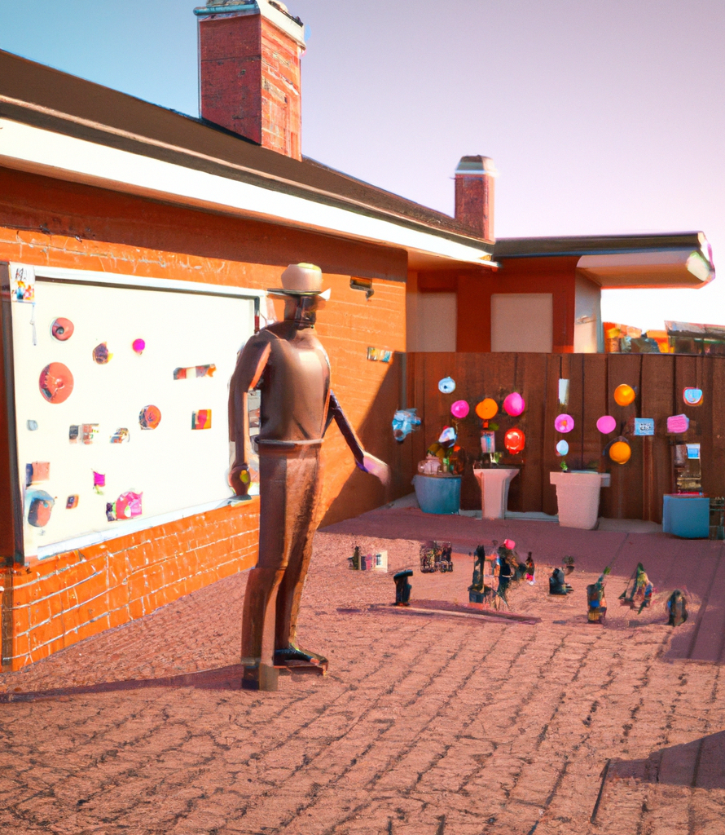
The Benefits of an IoT-Based Smart Security System
Cost-effective: Raspberry Pi is an affordable and powerful single-board computer that can be used to build a smart security system. The webcam and motion sensor are also relatively inexpensive components, making this solution a cost-effective alternative to traditional security systems.
Remote monitoring: The system can be accessed remotely from anywhere with an internet connection, allowing homeowners to monitor their premises from their smartphones or computers. This feature is especially useful for those who travel frequently or have multiple properties.
Real-time alerts: Email notifications provide homeowners with real-time alerts when motion is detected, allowing them to take immediate action if necessary. This feature can help prevent theft or damage to the property.
Easy installation: The system can be installed easily without the need for professional installation or wiring. This feature saves time and money on installation costs.
Scalability: The system can be easily expanded by adding additional sensors or cameras to monitor larger areas or multiple properties.
Energy-efficient: Raspberry Pi is designed to be energy-efficient, consuming very little power compared to traditional security systems. This feature helps reduce energy costs and makes the system eco-friendly.

Slide 7
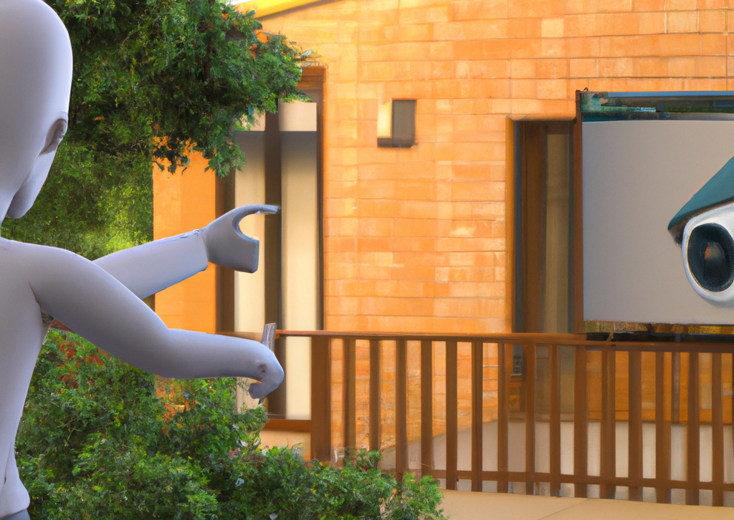
Real-Time Notifications and Live Camera Feeds
IoT-based smart security systems offer a range of benefits for homeowners. With real-time notifications and a live camera feed, you can stay connected with what’s happening. Plus, you can customize the settings to fit your needs, so you can be sure your home is always safe and secure.
With an IoT-based smart security system, you can enjoy peace of mind knowing your home is being monitored and that you’ll be notified if something is detected. Plus, you can access the live camera feed from anywhere, so you can keep an eye on your home even when you’re away.

Slide 8
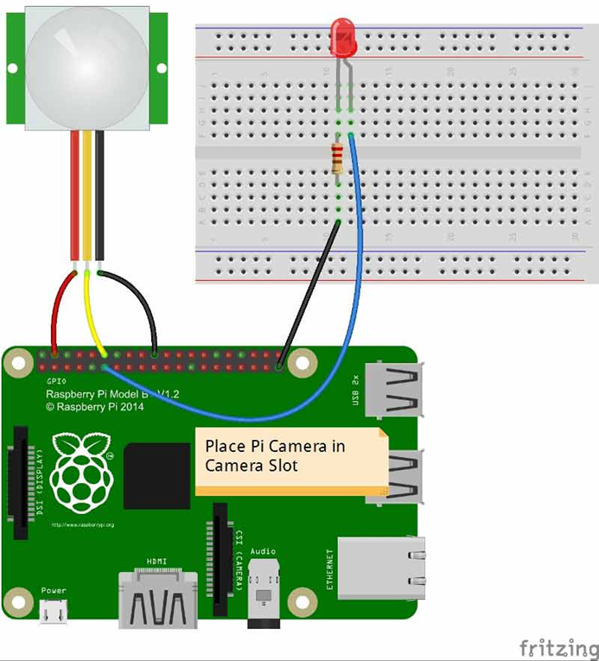
System Architecture and Design
Raspberry Pi running Raspbian
USB Camera
PIR Sensor
USB Wi-Fi Module for internet access ( optional, if you connect your Ethernet cable for internet, USB Wi-Fi Module is not needed )
Power Adapter to power the Rsapberry Pi

Slide 9
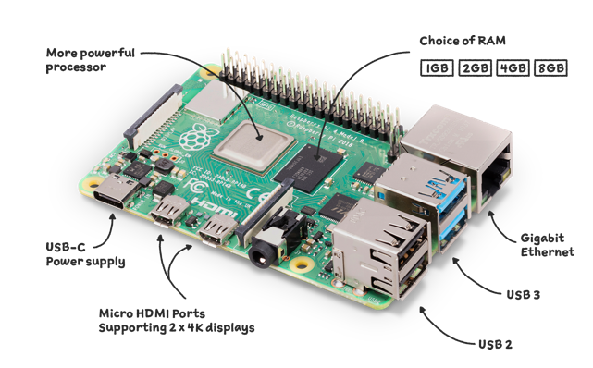
Methodology/Algorithms used
STEPS:
1.Setting Up Your Hardware Device
2.SETTING UP YOUR RASPBERRY PI WITH RASPBIAN OS like you need to install Raspbian on your micro sd card that you will be using in your Raspberry Pi.
3. INSTALL OPENCV AND REQUIRED LIBRARIES

Slide 10

Basic Details Implementation
Connect the USB webcam and PIR motion sensor to the Raspberry Pi board using jumper wires and breadboard.
Install the Raspbian operating system and necessary software libraries on the Raspberry Pi board.
Write a Python program that captures video frames from the webcam and performs motion detection using the OpenCV library. When motion is detected, the program should capture an image and send an email notification to the homeowner using the SMTP library.
Run the Python program on the Raspberry Pi board continuously to monitor for any motion and send email notifications as necessary.

Slide 11
REFERENCES
[1] https://raspberrypihq.com
[2] M. Al-Kuwari, A. Ramadan, Y. Ismael, L. Al-Sughair and A. Gastli, "SmartHome Automation using IoT-based Sensing and Monitoring Platform," IEEE, 2018.
[3] S. Tanwar, P. Pately, K. Patelz, S. Tyagix, N. Kumar and M. Obaidat, "An Advanced Internet of Thing based Security Alert System for Smart Home," IEEE, 2017.
[4] R. Khana and U. Usnul, "Rancang Bangun Sistem Keamanan Rumah Berbasis IoT dengan Platform Android," Ejournal Kajian Teknik Elektro Vol.3 No.1, pp. 18-31, 2018
[5] D. Yendri and R. E. Putri, "Sistem Pengontrolan Dan Keamanan Rumah Pintar (Smart Home) Berbasis Android," pp. 1-6, 2018.

Slide 12
CONCLUSION
In conclusion, an IoT-based smart security system using Raspberry Pi, webcam, motion detection, and email notification is a cost-effective, efficient, and scalable solution for improving home security. The system can be easily installed without professional help, and it can be accessed remotely from anywhere with an internet connection.

Slide 13
THANK YOU

